Slide 1

Approximate Nearest Neighbor Search algorithms for web-scale search and recommendation
Presenter: Harsha Simhadri (Microsoft Research India)
Based on work with: Ravishankar Krishnaswamy (MSR India), Gopal Srinivasa (MSR India), Sujas J Subramanya (CMU), Aditi Singh (U. Wisconsin), Rohan Kadekodi(UT), Devvrit (UT), Shikhar Jaiswal (MSR India), Magdalen Dobson(CMU), Siddharth Gollapudi (MSR India), Neel Karia (Columbia), Varun Sivasankaran (MSR India)

Slide 2
Agenda
Background
Renewed interest in Nearest Neighbor Search and use cases
Gap between literature and practical requirements
DiskANN
State-of-the-art suite of algorithms
Ideas & measurements
Directions
Dataset and benchmark release
New directions & some preliminary results

Slide 3
Deep learning is changing search and recommendation
From literal matches and fixed features to Semantic matches via Embeddings
Encoding of objects (sentences/images/weg pages) into points such that
objects with nearby points are more likely semantically similar or relevant
Dog (0, 1, 23, -12, 20)
Cat (2, 1, 19, -7, 22)
Car (20, -10, -5, -12, 10)
Ship (16, -13, 0, -8, 12)
Sailor (12, -4, 4, -12, 15)
7
37.48
8.367

Slide 4

Semantic search using ANNS for Retrieval
Obj
Doc
Embed
Doc
Doc
Doc
Doc
Doc
Doc
Doc
Obj
Embed
Query
Database
N = 10⁶ or 10⁹ or 10¹² points
K=4 nearest neighbors (l₂)
R^{d} d~100-1000
Exact retrieval might need exhaustive scan, settle for approximate retrieval.
Measure Recall@k: fraction of output candidates that are true top-k nearest neighbors

Slide 5
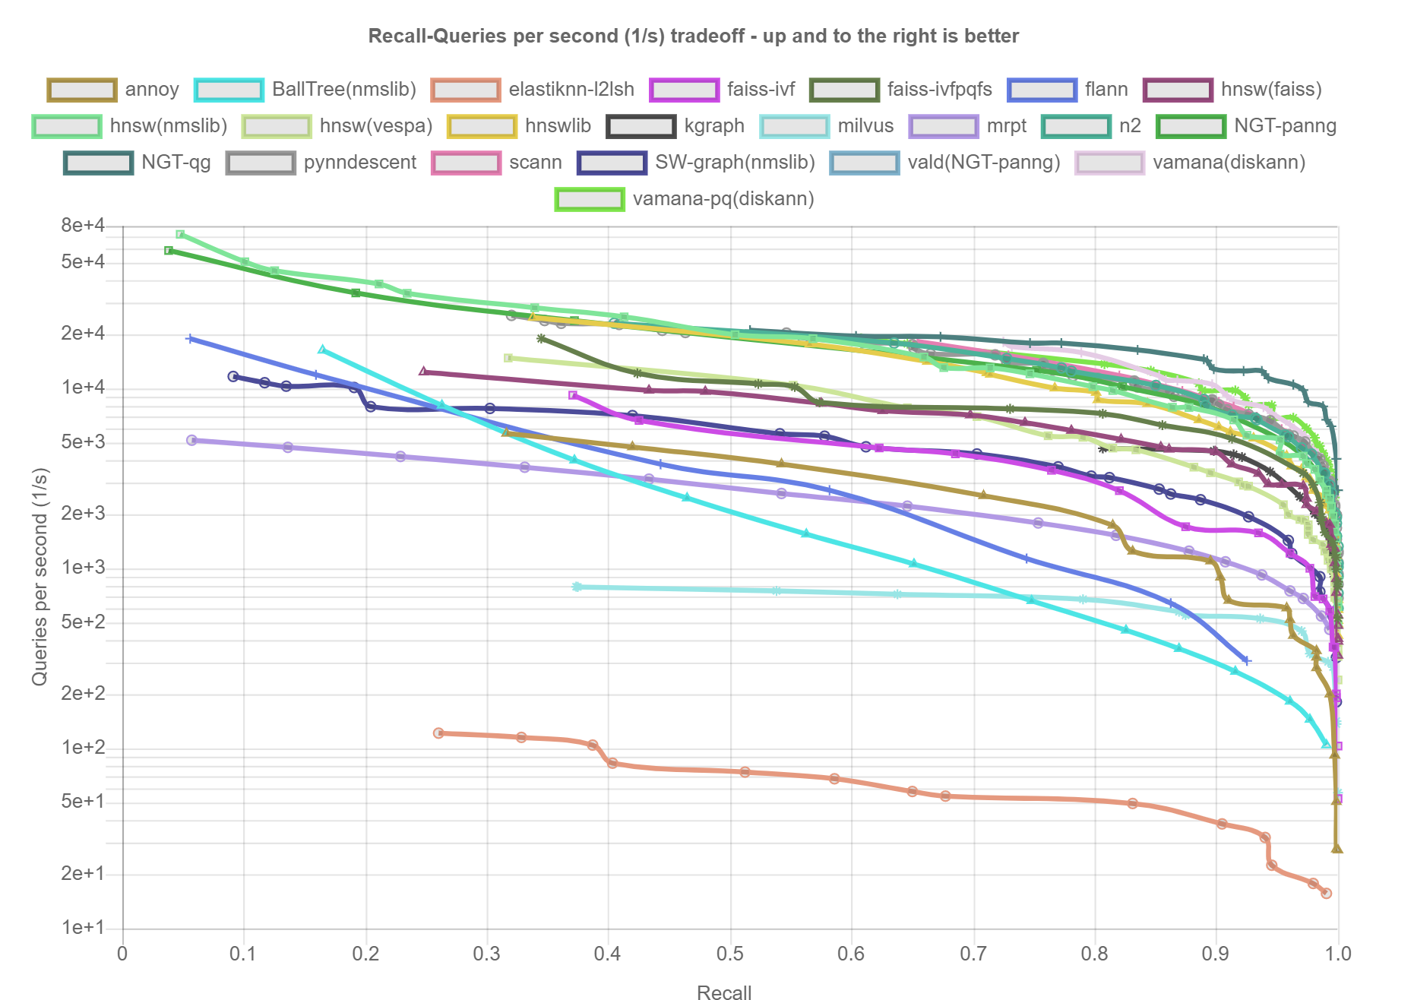
Long history of work.. In academia and industry
ann-benchmarks.com
SIFT Image descriptors
1M points, 128 dimensions, L2 distance
Trees: k-d trees [Bentley, C.ACM’75], cover trees [Beygelzimer, Kakade, Langford, ICML’06]…
Clustering: IVF [FAISS, Babenko & Lempitsky, CVPR 2012, Tavenard et al., ICASSP’11], …
Hashing: LSH[Indyk, Motwani, STOC’98; Charikar, STOC’02], Data dependent hashing [Andoni, Razenshteyn, STOC’15],…
Graph based: NSW, HNSW[Malkov, Yashunin, T.PAMI’18], NSG [Fu et al, VLDB’19], NGT [Iwasaki], SPTAG[Wang et al., CVPR’12], HCNNG[Muñoz et al., Pattern Recognition 96], …
Compression techniques
PQ [Jegou et al., PAMI’11], OPQ [He et al., CVPR’13],.. for l₂
ScANN[Guo et al., ICML’20] for maximum inner product
Domain specific:
Sparse high-dimensional
Geospatial

Slide 6
ANNS at scale: size, speed and freshness
 | Web Search & Reco | Email Search | Enterprise search
Index Size | ~1 trillion pages | 100s of trillions of sentences | Trillions of paragraphs across documents
Update Rate (latency <1s) | Billions of updates/day | Ingest new email, Purge deletes | Handle >1% change/day
Search latency/QPS | <10ms 10-100K+ Queries/sec | 100s of ms | 10-100ms
Problem 1: Existing algorithms use in-memory indices for <10ms latency and high throughput
Problem 2: Graph indices hard to update. Need to be rebuilt from scratch periodically.
10,000s of machines (100GB DRAM) to serve a trillion-point index for web search
10,000s of machines to
periodically rebuild indices
every 6 or 12 or 24hrs
DiskANN [NeurIPS’19]: Index 5-10x more points/machine using inexpensive SSDs; serve with <10ms latency and 10000+ QPS.
Fresh-DiskANN [arXiv:2105.09613]:
DiskANN + Real-time freshness + 1000s of inserts&deletes/sec

Slide 7
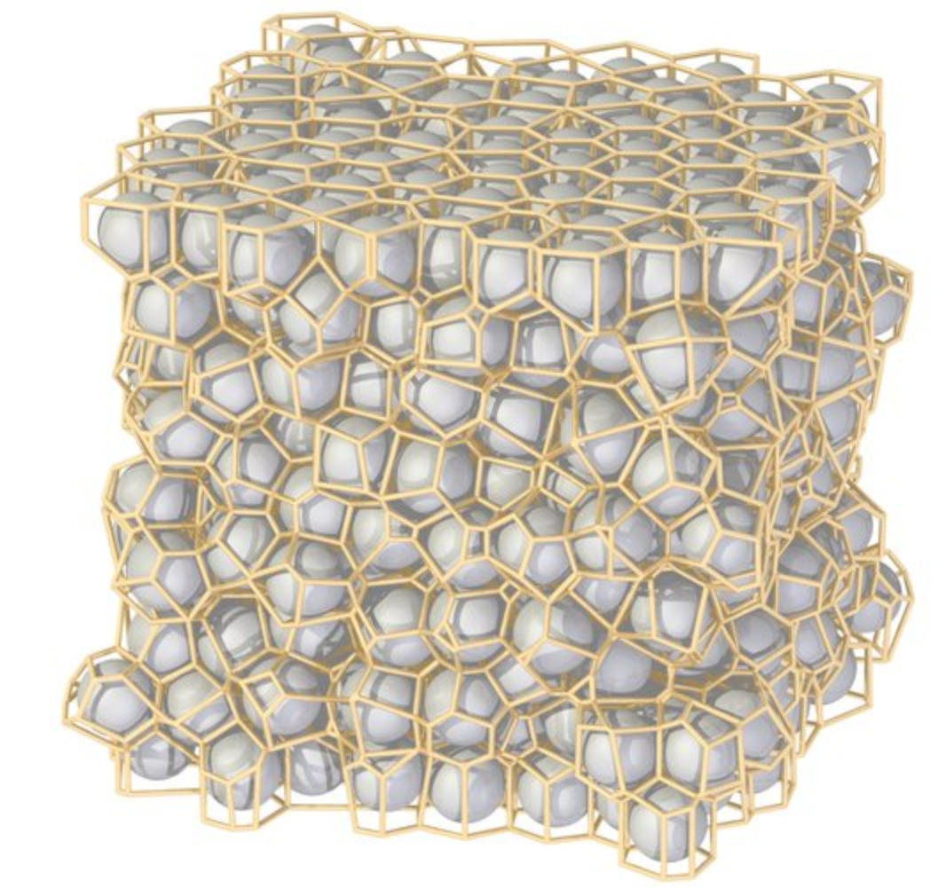


Clustering + compression-based algorithms: A primer
Popularized by Facebook AI Similarity Search [FAISS] package
Pre-processing/index build
Compress each vector into 32 bytes so billion points fit into 32 GB RAM
Cluster points into k=n^{1/2} clusters (k=32000 for n=1B)
Query time
Find w closest clusters to query
Retrieve all points from these w clusters
Output top-k based on approximate distances using compressed vectors
Main drawback: compressed vector distances are lossy and susceptible to noise
High density of points/machine
Low recalls

Slide 8
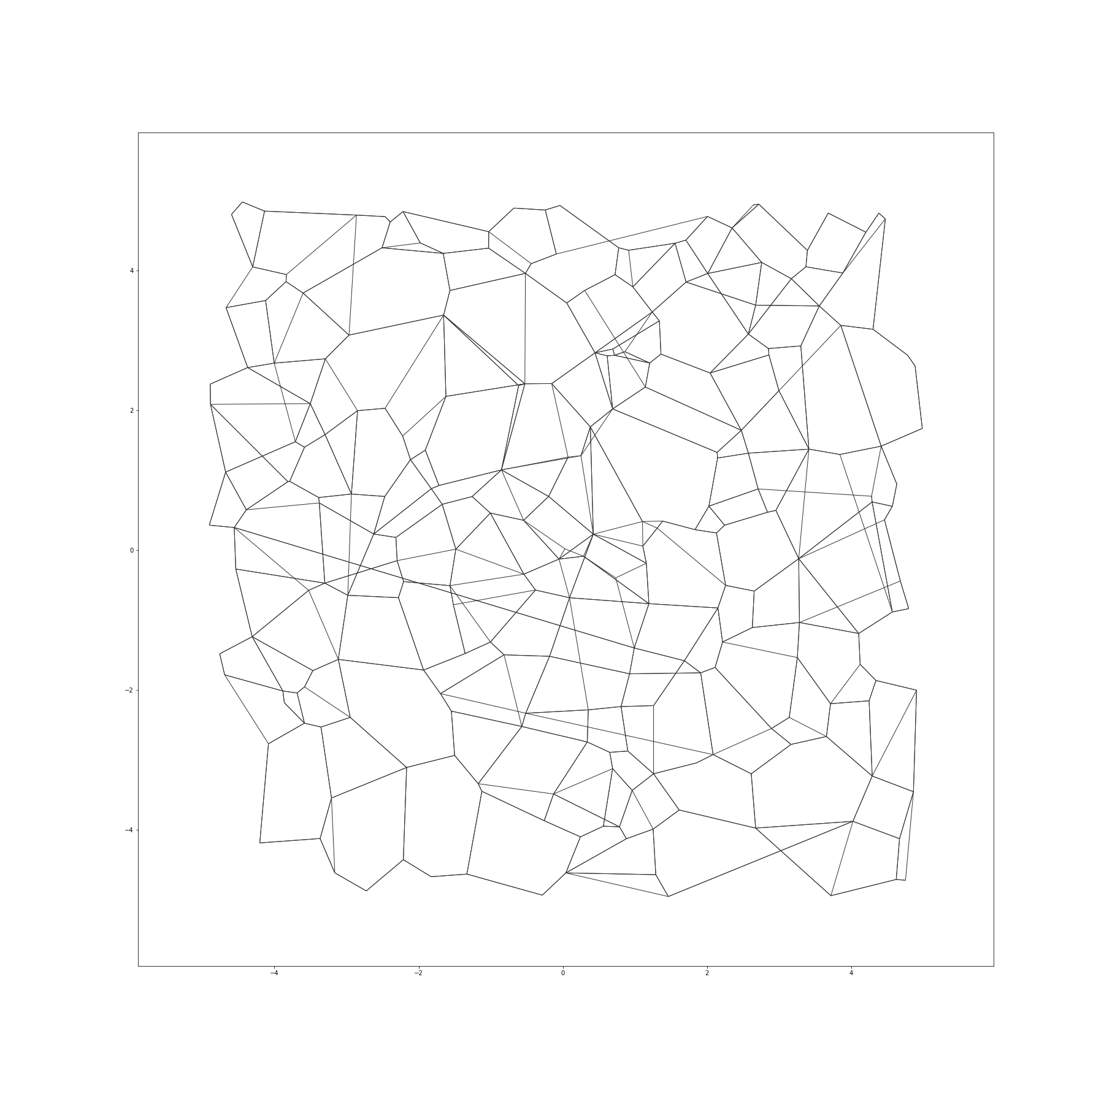
Graph-based ANN indices: a primer
Index: One vertex per data point/embedding. Directed edges between vertices with O(log n) degree.
For query q:
Start at designated start s, and iterate:
compute dist. from q to neighbors
hop to node closest to q,
as long as distance improves
Index build: Create a O(log n)-degree graph that guides queries with the fewest hops and distance comparisons
s
q
High recall and low latency
Data and graph in memory
Only ~100M points/machine

Slide 9
LSH, Clustering, Graph at 100 million scale
Cross-polytope LSH from FALCONN library [Razenshteyn’16]
number of tables = {10 15}, probe width = {25 50 100 200}, dimension of last polytope = {4 8 16 32}, cross polytope number = 4, number of rotations = 3

Slide 10
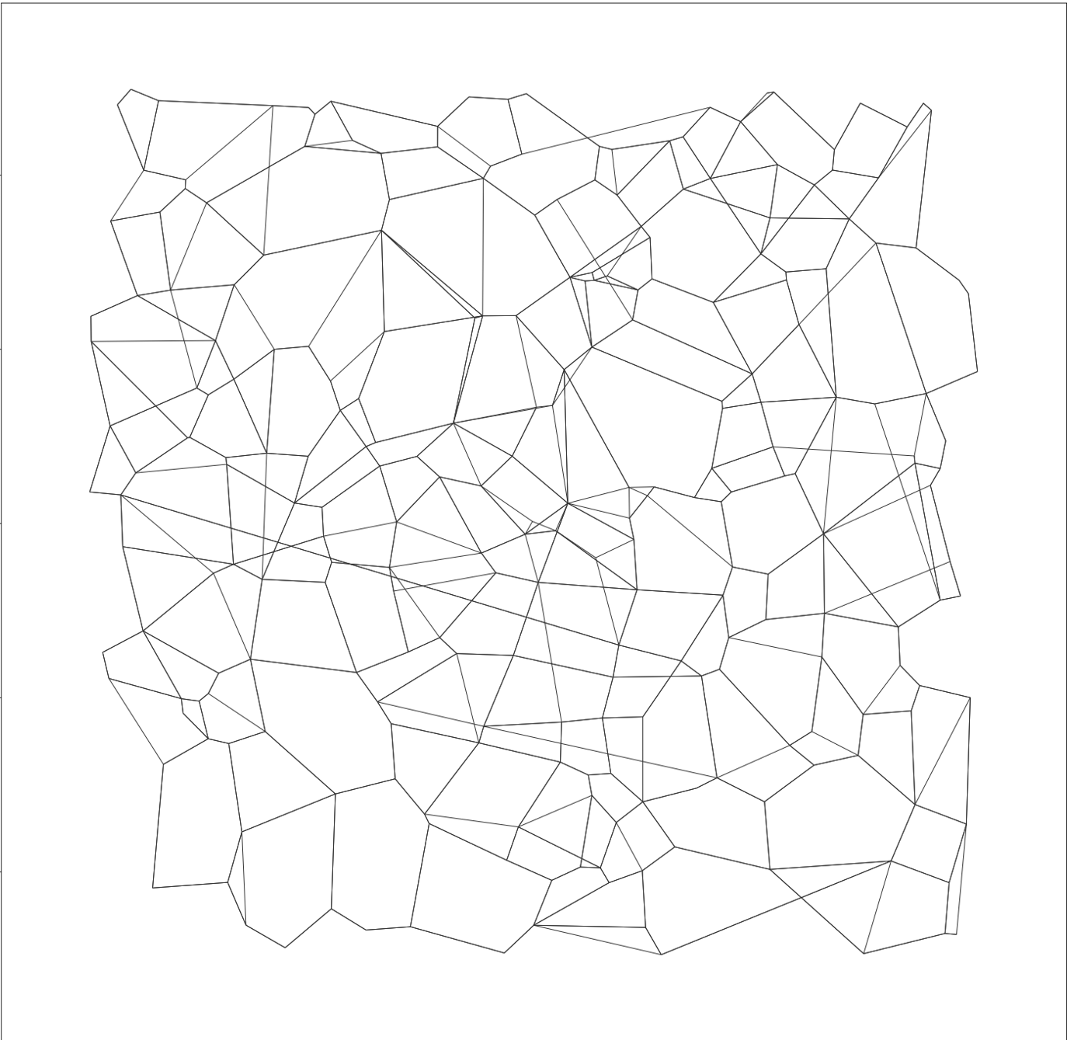
DiskANN [NeurIPS’19]: High recall, low latency via hybrid DRAM+SSD index
Compressed vectors (~32B)
DRAM
1B Vectors (100-1000d) + Graph(~100 degree) ~ 500GB-1TB
Low Diameter (<10 hops)
SSD
s
GreedySearch(q)
Let p := s (start node)
Fetch neighbors of p from SSD
Use compressed representation of points to find neighbor p closest to q
q

Slide 11
Index build, point by point
G
s
G.insert(p, R, α) // R is degree bound, α>=1 constant
V ← vertices visited by G.search(p) // |V|~5-10K
V’← Prune(p, V, R, α)
For all v ∈ V’
add edges (p,v) and (v,p) to G
if |N_{out}(v)| > R
N_{out}(v) ← Prune(v, N_{out}(v), R, α)
p

Slide 12
G
Index build: prune candidates to size
s
G.insert(p, R, α) // R is degree bound, α>=1 constant
V ← vertices visited by G.search(p) // |V|~5-10K
V’← Prune(p, V, R, α)
For all v ∈ V’
add edges (p,v) and (v,p) to G
if |N_{out}(v)| > R
N_{out}(v) ← Prune(v, N_{out}(v), R, α)
p
v₇
v₃
Prune(p, V, R, α) returns V’ // |V’|<R is degree, α typically 1.2
Sort V in increasing order of distance from p
V’← {v₁}
for i ∈ {2, …, |V|} while |V’| < R
if for any v ∈ V’, d(v,v_{i}) < d(p,v_{i})/α, skip i & continue
else, add v_{i} to V’
v₄
v₁
p
v₆
v₂
v₅

Slide 13
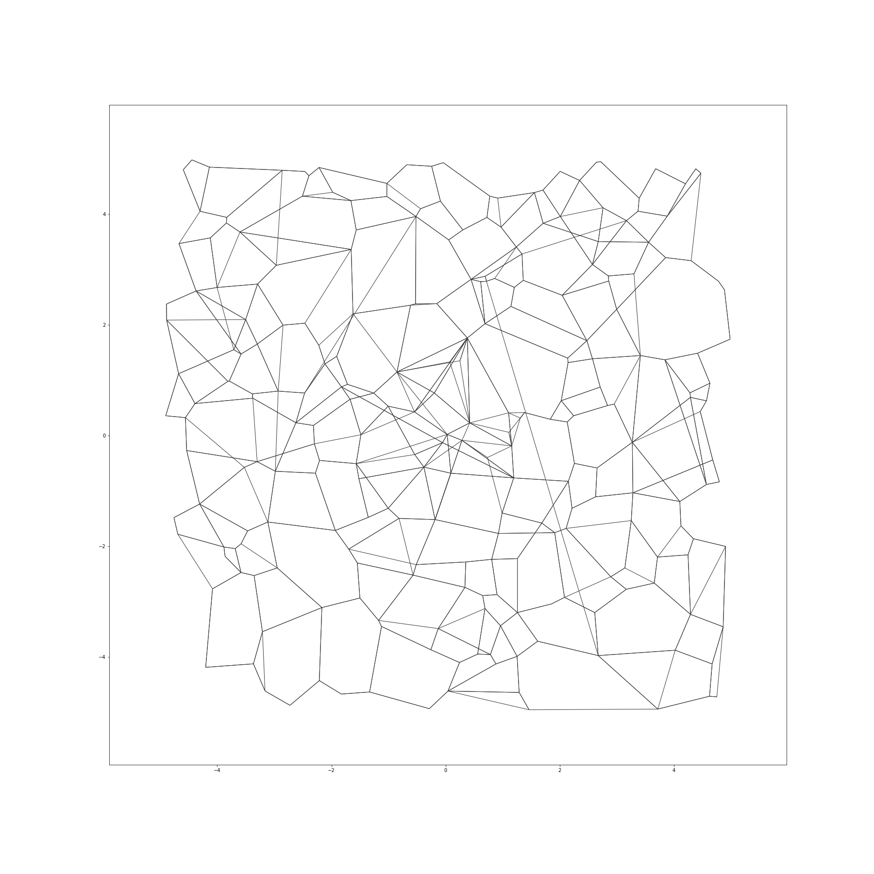
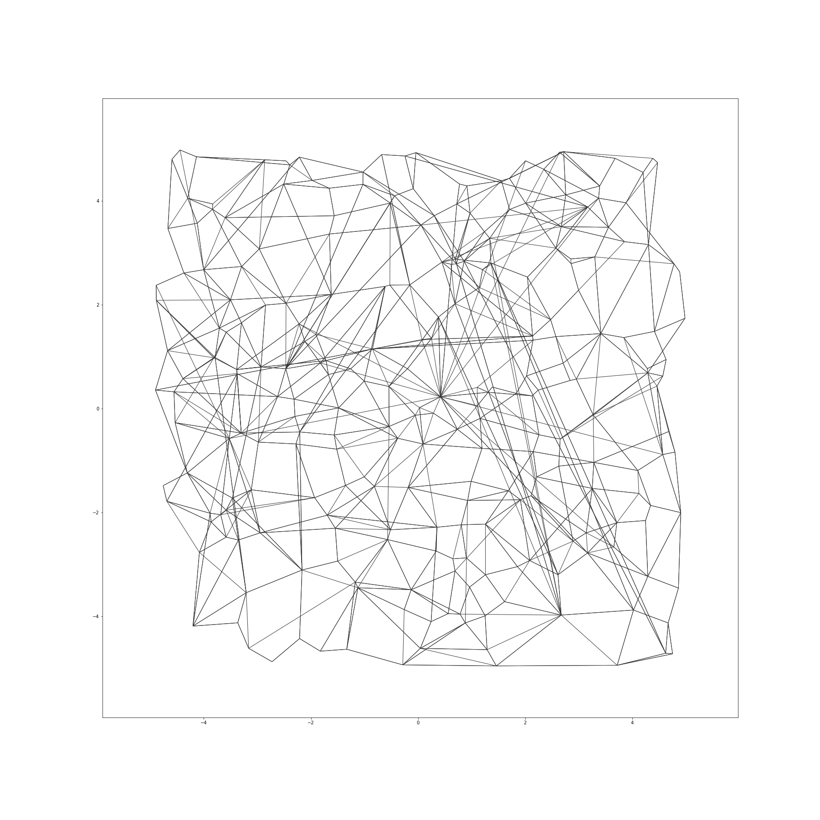
Index properties: dependence on alpha
α=1
α=1.2

Slide 14
Index properties: BFS and graph diameter (α=1.2)
BFS level (from designated start point) | # points at BFS level i (1billion point MS SPACEV dataset)
1 | 100
2 | 9946
3 | 891273
4 | 52050789
5 | 682738849
6 | 252099714
7 | 11835439
8 | 190225
9 | 104202
10 | 47656
11 | 11095
12 | 1536
13 | 212
14 | 24
15 | 1
BFS level (from designated start point) | # points at BFS level i (1billion point MS BIGANN dataset)
1 | 73
2 | 3868
3 | 213058
4 | 10864635
5 | 226069439
6 | 673168120
7 | 88167475
8 | 1487493
9 | 6645
10 | 798
11 | 131
12 | 16
13 | 1
98% of points <= 6 hops from start
90% of points <= 6 hops from start

Slide 15
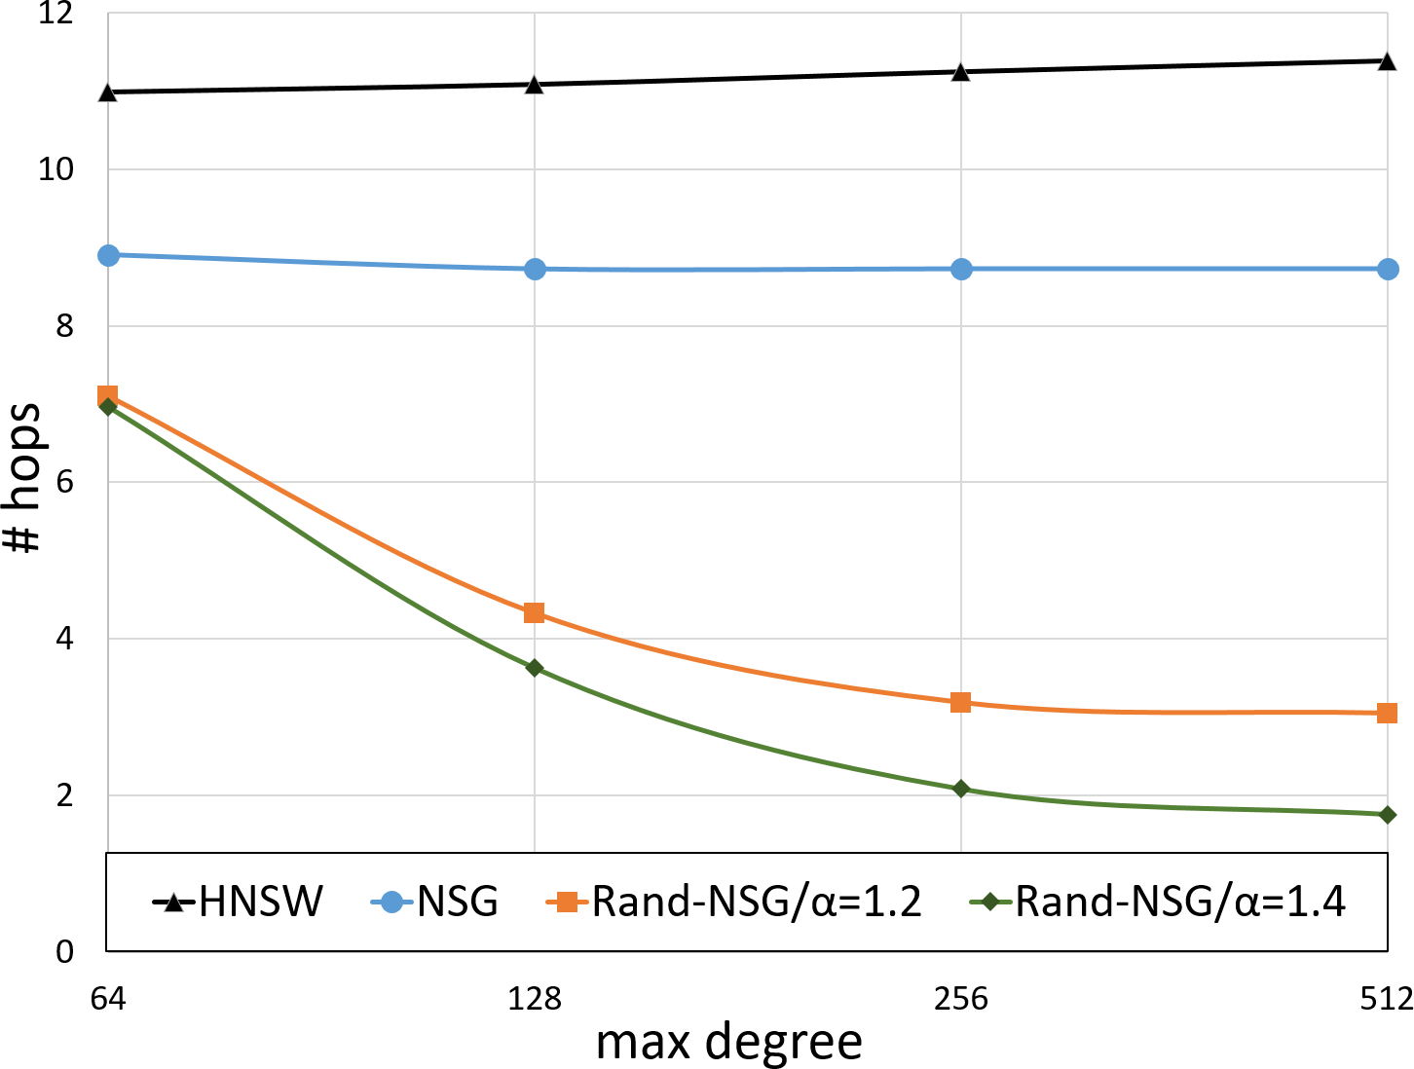
Round-trips to SSD: Comparison with other graph algorithms
Search Parameters
PQ size 32, Ls=30
Beam-width, W = 4
DiskANN
DiskANN

Slide 16
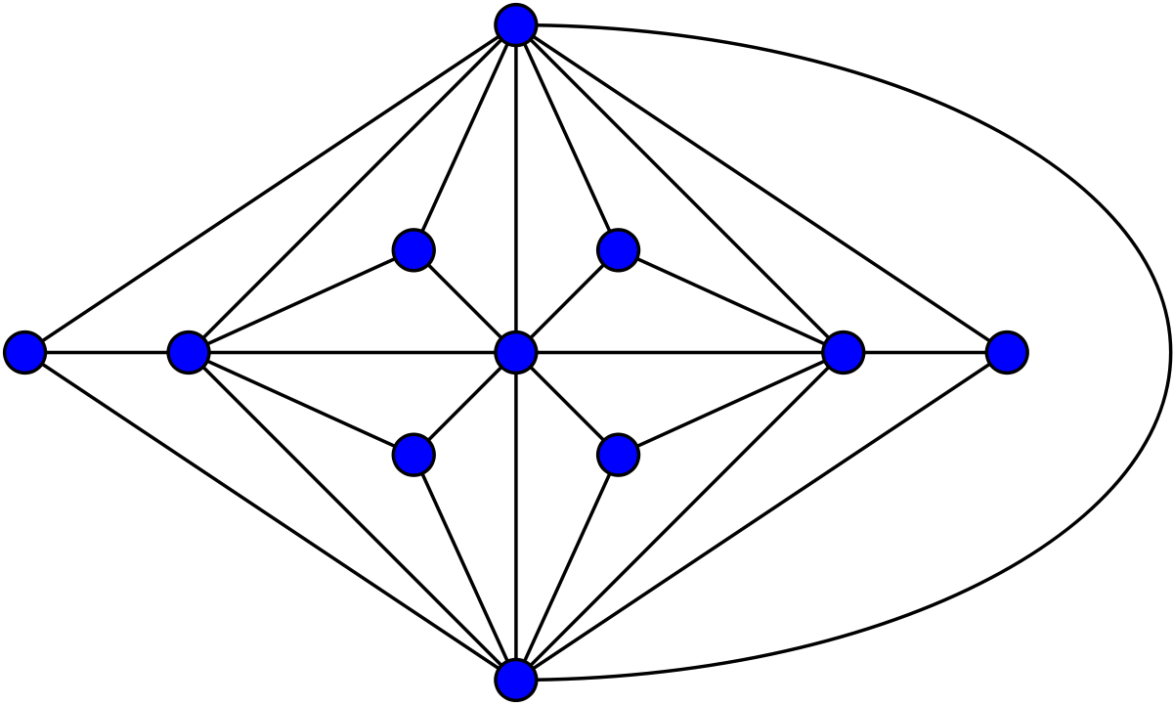
Sharded construction for datasets larger than memory
Divide & Conquer:
Cluster data into partitions/clusters that fit into memory (1B points + 100GB RAM limit -> 10 to 20 shards)
send each point to be indexed to 2 nearest clusters
Build graph on each shard
Final graph is the edge union of smaller graphs
Cleanly avoids “boundary effects” which arise due to k-means partitioning

Slide 17
Recall, latency, QPS and IO/s for 100-degree graph
BIGANN dataset: 1Billion points in 128 dimensions
Memory footprint = 32GB + 250K adjacency lists cached in memory ~ 33GB
In comparison, in-memory graph indices (e.g. HNSW) would need 500GB+ DRAM

Slide 18
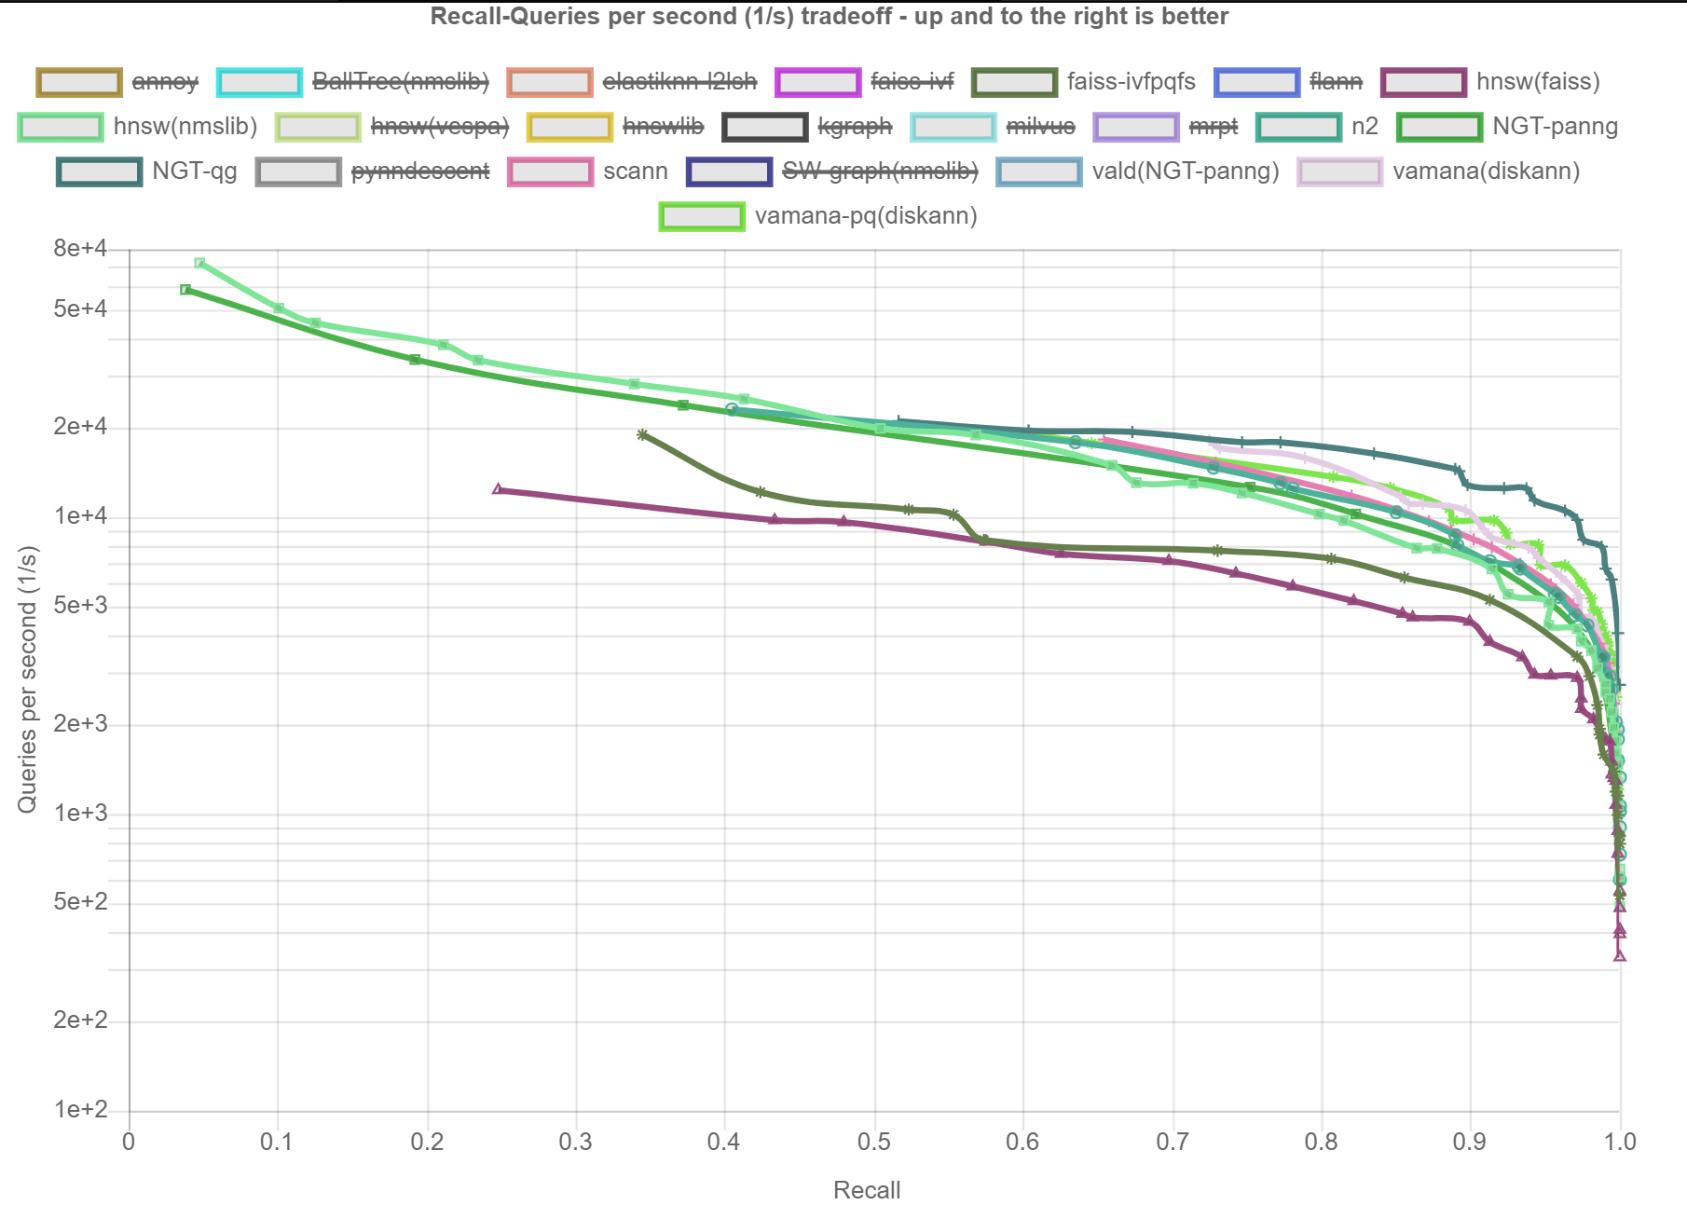
In-memory performance comparison with other graph indices

Slide 19
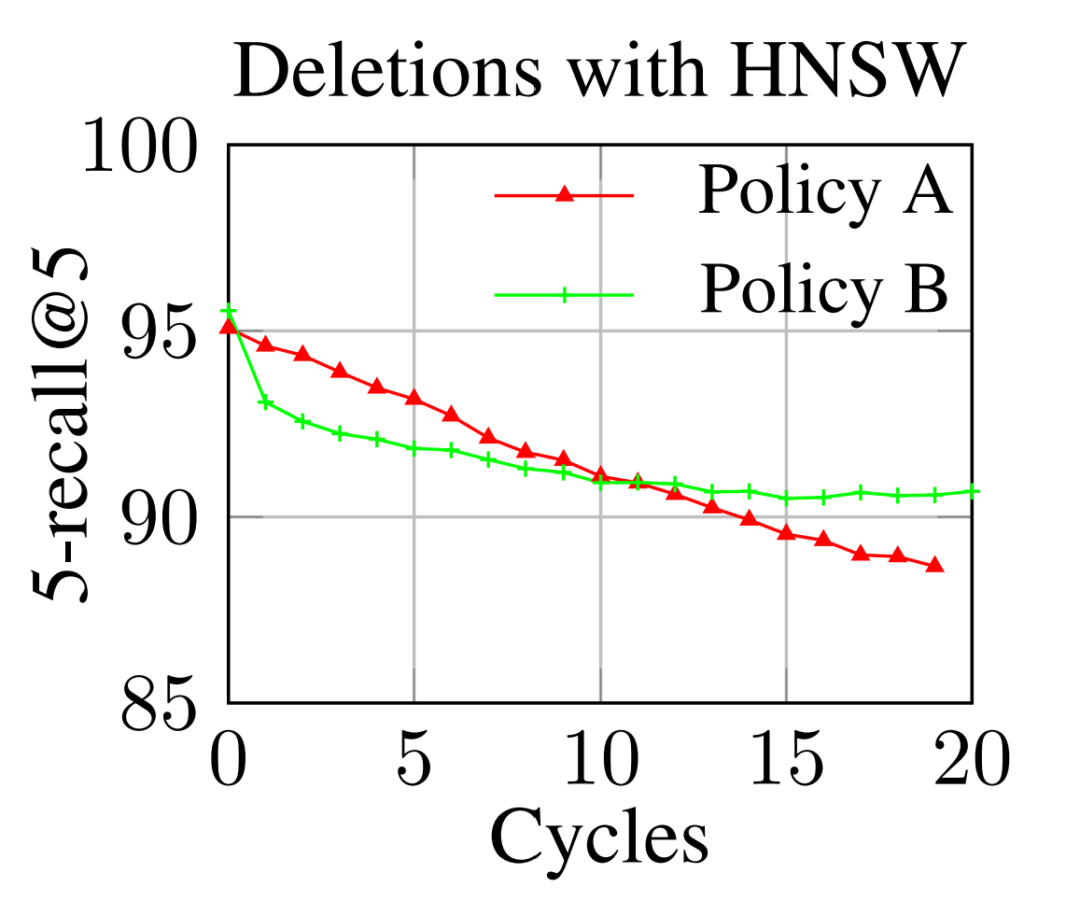
Deletes: Are they easy?
Policy A (drop): drop graph vertices corresponding to deleted points.
Policy B (shortcut): To delete vertex p, for any pair of directed edges (p_{in}→ p) and (p→p_{out}) in the graph, add the edge (p_{in}→ p_{out}) in the updated graph.

Slide 20
FreshDiskANN: DiskANN + concurrent updates
Index over D~D
Insert X~D
Delete Y~D
Index over D U X \ Y
100%
100%
Recall
Recall Stability:
Same search params
➔ Same recall
Recall
Search Params/Complexity
Search Params/Complexity
First graph index that supports inserts/deletes with recall stability (empirically).
No theoretical guarantees or adversarial bounds, yet.
A streaming system that supports concurrent updates and search
User facing latency: ~10ms search, ~1ms insert. Real time freshness.
1000s of inserts, deletes and queries/sec/node
Primarily backed by SSD, Low memory footprint (128GB for ~1B points in 100 dimensions)

Slide 21
Delete (v)
u
For all u, that are in-neighbors of v,
N(u) ← N(u) U N(v)
If |N(u)| exceeds budget
prune N(u) with α>1
v
u
u
Eager execution requires in-graph, which doubles memory footprint
In practice, do lazily, to avoid in-graph and amortize cost better

Slide 22
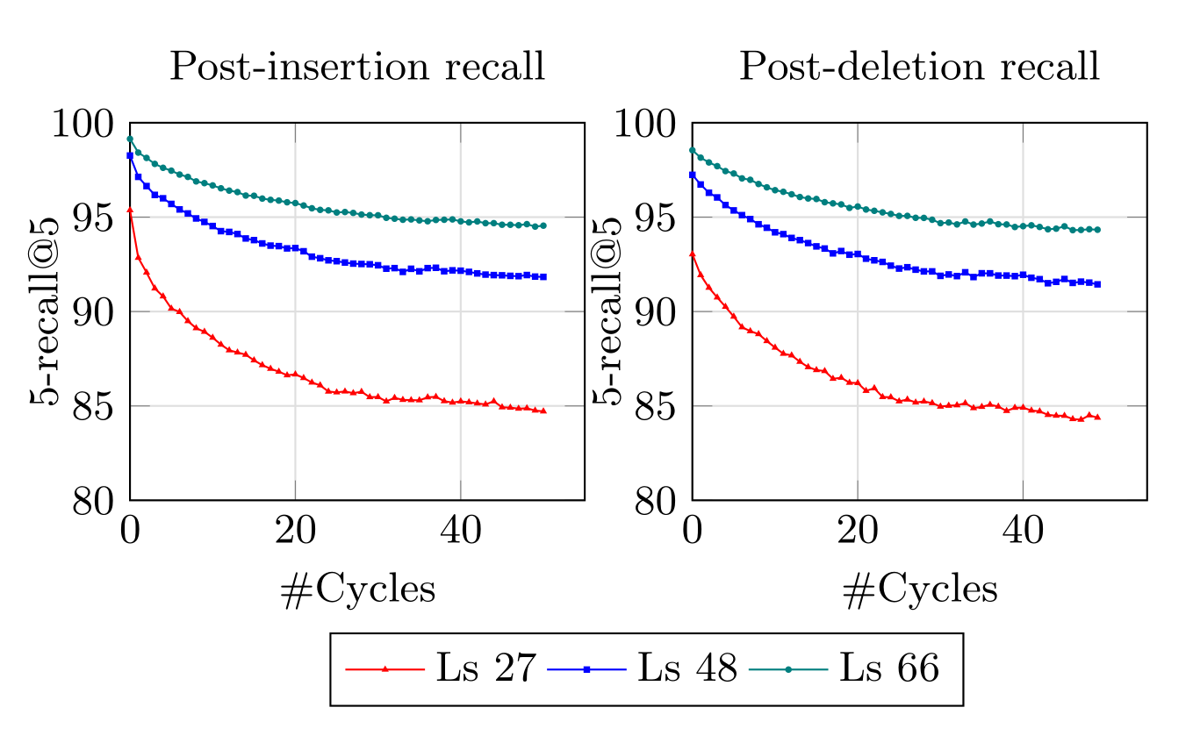
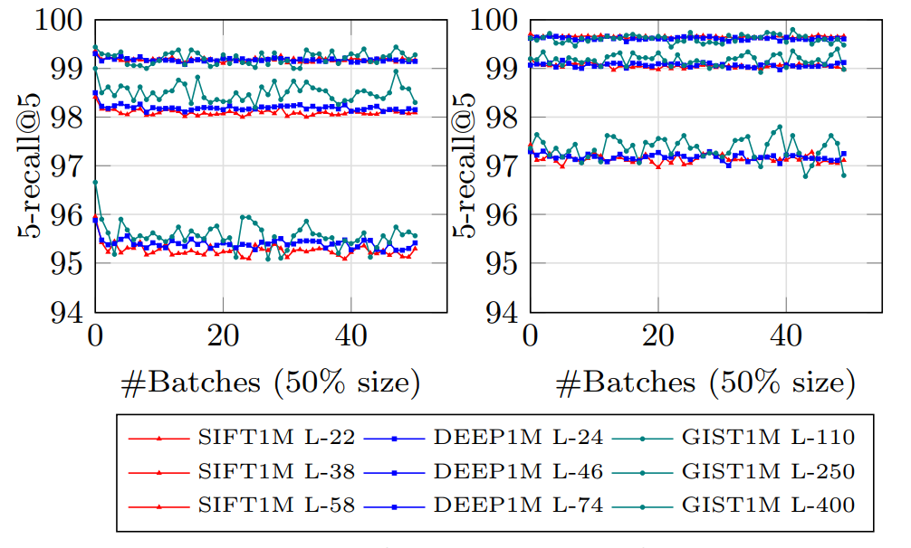
Recall stability
Evolution of search recall of DiskANN (α=1.2) over 50 cycles of deletion (right) and reinsertion (left) of 50% of data for 3 datasets with varying search parameter.
Same experiment with α=1
Recall degrades over iterations

Slide 23
Fresh-DiskANN System
append
Delete List
Delete (v)
Delete List
Insert
RW-Short-Term Index
Insert (v)
RW-Short-Term Index
Memory
RW-Short-Term Index
RO-Short-Term Index
Search (v)
RO-Short-Term Index
Snapshot
: 2-pass streaming algorithm
DRAM footprint proportional to #new points, not overall index
Periodically invoked in the background
Merge
SSD
New Long-Term Index
Long-Term Index

Slide 24
Performance characteristics on ~1B point dataset
 | Machine Settings | Search throughput Queries/ second | Freshness (Insert/ delete latency) | Insert /Delete throughput | Recall | Merge time | Notes
FreshDiskANN | 1 machine 128GB RAM, 48 core Xeon 8160 Samsung PM1725a SSD | 1800 with 10 threads | <5ms insert Few μs for delete | 1800/sec | 90% recall@1 95%, 98% possible with slightly higher latency | ~4.5 for 30M inserts + 30M deletes ~2.5 hours for 30M inserts | 40, 2, 1, 10 threads for merge, insert, delete, search
DiskANN + rebuild daily | 2 machines for build 1 machine for serve | “ | 24 hours | N/A |  | 1 days to rebuild with 2 machines
PLSH [VLDB’13] | 100 machines 64GB DRAM, 8 core Xeon E5-2670, 64GB DRAM (total: 800 cores, 6.4TB DRAM) | ~700/sec | <1sec | 20000/sec w/100 machines |  | 20sec for 1M entries | 2% of time for merge estimates at

Slide 25
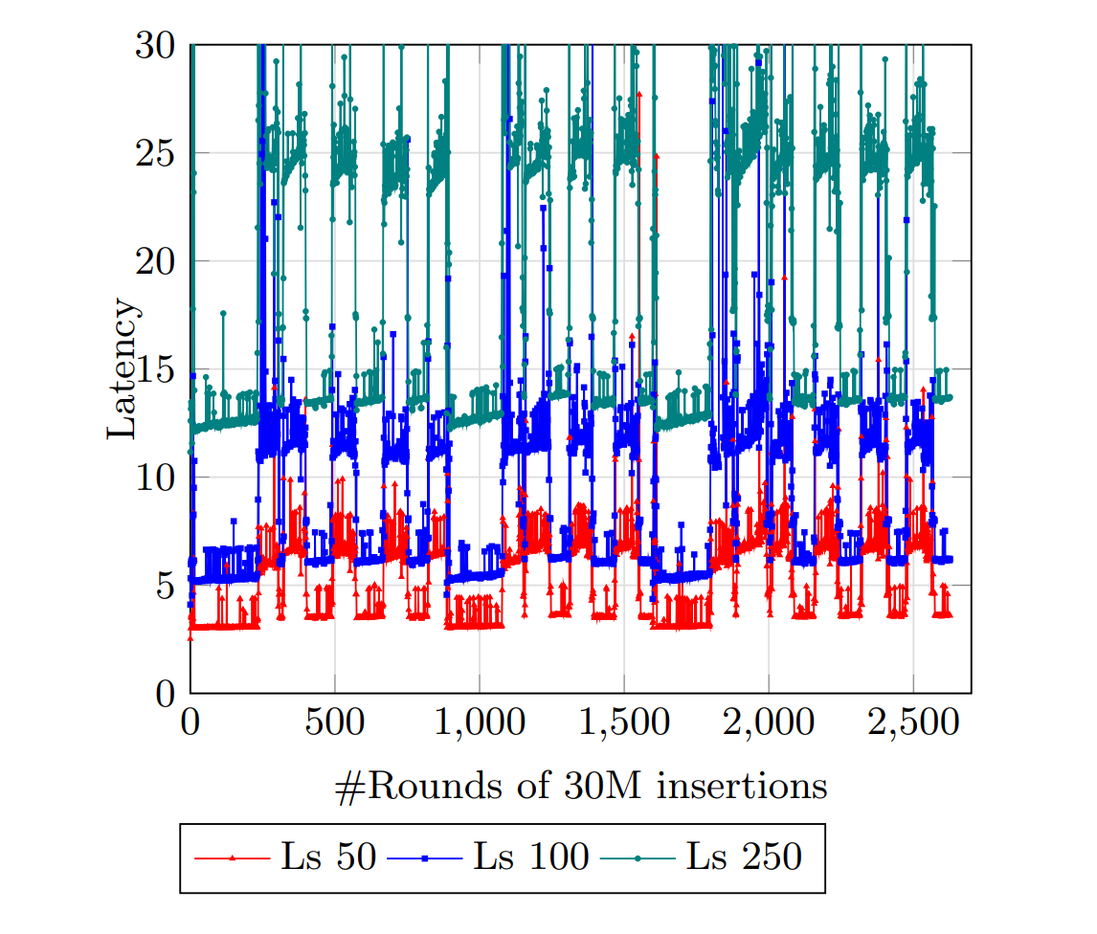
Performance characteristics on 800M point dataset
Machine:
48 cores, 2x Xeon 8160 CPUs
Samsung PM1725a SSD
Resource allocation
Max 128GB memory used
40, 2, 1, 10 threads for merge, insert, delete, search
Background merge process into 800M point index takes
~4.5 hours to process 30M inserts and 30 deletes
~2.5 hours to process 30M inserts
Compare with 2 days to rebuild index from scratch.
User facing performance
Insert takes ~1ms, delete takes <1 microsec
Supports 1800 inserts/sec + 1800 deletes/sec in steady state with above thread allocation without merge backlog.
Search latency trends over 5 days
Latency spikes during merge
Mean search latencies in milliseconds for search recall of >90% (Ls 50), >95% (Ls100) and >98% (Ls250) search recall over the course of ramping up an index from 100M points to 800M, in increments of 30M.

Slide 26
Harsha Simhadri* (Organizer for Track T1/T2), George Williams§ (Organizer for Track T3), Martin Aumüller¤, Matthijs Douze†, Ravishankar Krishnaswamy ^{*+}, Artem Babenko‡, Dmitry Baranchuk‡, Qi Chen*, Lucas Hosseini†, Gopal Srinivasa*, Suhas Jayaram Subramanya#, Jingdong Wang^ *Microsoft Research, §GSI Technology, ¤IT University of Copenhagen, †Facebook AI Research, ‡Yandex Labs, #Carnegie Mellon University, ⁺IIT Madras, ^Baidu
NeurIPS’21: Billion-Scale Approximate Nearest Neighbor Search Challenge
Track 1:
Standard Azure hardware,
limited DRAM (64GB)
Baseline: FAISS IVF + PQ
Track 2:
Standard Azure hardware,
Limited DRAM(64GB) + 2TB SSD
Baseline: DiskANN
Track 3:
Any hardware,
Cost- and Watt-normalized query throughput
Winner: Intel’s adaption of DiskANN to Optane pmem
https://big-ann-benchmarks.com/
[Thanks to Microsoft for generous support including Azure credits for participants and organizers]

Slide 27
Six Billion-scale Datasets from INRIA/IRISA, Facebook (now Meta), Microsoft, Yandex
Dataset | Source | Size | Encoder/Task | Other notes
BIGANN-1B | CNRS/IRISA http://corpus-texmex.irisa.fr/ | 128 dims uint8 L2 | SIFT descriptors for image similarity
SSNPP-1B* | Facebook | 256 dims uint8 L2 | SimSearchNet++ image encoder | Range search
SpaceV-1B* | Microsoft https://github.com/microsoft/SPTAG/tree/master/datasets/SPACEV1B | 100 dims int8 L2 | Docs and queries encoded by Microsoft SpaceV Superior model to capture generic intent representation.
Turing-ANNS-1B* | Microsoft Turing | 100 dims float L2 | Bing queries encoded by Turing AGI v5 encoder.
Text2Image-1B* | Yandex https://research.yandex.com/datasets/biganns | 200 dims float Inner-product | Images encoded by Se-ResNext-101 model, queries are text encoded by a variant of DSSM | Cross-modal; Query distribution different from index set
DEEP-1B | Yandex https://www.cv-foundation.org/openaccess/content_cvpr_2016/app/S09-38.pdf | 96 dims float L2 | GoogLeNet pretrained for Imagenet classification task + PCA + l2 normalized
[ * new datasets released for the competition]
Notes:
Thanks to researchers from different organizations, we have compiled a preliminary list of 6 billion scale datasets for benchmarking the algorithms. They vary in terms of the dimension and the prevision of the embeddings, the model that generated them, the application they arise in, and the domain they belong to, and in a few other ways I will high light here.
The first, BIGANN-1B, is a dataset which has existed for 10 years and is commonly used for benchmarking in many of the billion scale indexing algorithms. It constists of SIFT image descriptors for 1 billion images that encode image similarity. It is 128 dimensional and has 8 bits of precision per coordinate.
The second, SSN++-1B is a newly released dataset from facebook consisting of higher dimensional encodings compression to 256 bytes using PCA. The encoder is the simsearchnet++ model and the application is to enable tagging of offensive content on Facebook platform. This is different from the other datasets in that it uses range search as opposed to k-nearest neighbors. As in, it asks for all points within a radius of the querys embeddings.
The third and the fourth datasets are newly released by Microsoft and are aimed at capuring generic intent representation in web text. The first of the two, spaceV consist of documents and queries encoded by Microsoft SpaceV superior model and is 100 bytes per emebding. The second of the two, release by Microsoft Turing team, consist of Bing queries encoded by Microsoft Turing AGI v5 model and aims to relate similar web queries.
The fifth, text2image is a newly release dataset from Yandex. It is different from the others in that it uses max inner-product search as opposed to L2 metric. It is also the largest dataset at 800GB. further, it is a cross modal dataset where the quey vectors are text queries encoded with a variant of DSSM, while the indexed set consists of images encoded by Se-ResNext-101 model. As a result, the distribution of the queries is different from the base set, and this dataset is particularly hard for most ANNS algorithms including the baselines included in the competition. To help further algorithm development for out of distribution queries, Yandex researchers have also release 50 million sample query vectors.
Finally, the sixth dataset is a DEEP-1B released earlier and consists of 96 dimensional floating point image descriptors encoded using the final FC layer of Googlenet model pretrained for imagenet classification and then compressed using PCA and L2 normalized.

Slide 28
Can we design ANN indices so accurate, cost-efficient, reliable and feature-full that it is primary search index for all search and recommendation applications?
e.g. web/email/doc/image/audio/map/molecule search, personalized document/news/task recommendation
Interesting problems with connections to research in Algorithms, Machine Learning, Databases, HPC.

Slide 29
Direction 1: ANNS + Filters
Given: P = {p_{1,} p_{2,} p_{3, …,} p_{n}} in R^{d}, a set of labels {L_{1,} L_{2,}…, L_{k}}, and an association of labels to each point p_{i} → {L_{i1}, L_{i2}, ..}, construct an ANN data structure that efficiently supports the following queries…
For query q in R^{d}, with labels L_{q}={L_{q1}, L_{q2}, …}, find points in P nearest to q that have any of labels in L_{q} associated with them.
Examples:
search best matching email from author X (points = email, labels = authors)
Find best webpages that are relevant for a region (points = webpages, labels = regions)
Find document in an enterprise from a domain/sub-domain (points=document, labels=domains)
Images from the web matching a text description or your photo, but of certain size or background color
Baselines?
Post-filtering: standard ANN algorithm following by filter by label
Not so good for “rare” labels
Pre-filtering: construct a separate ANN index for each label
Too many indices, since the relation between points and labels is many-to-many
Goal: Match the search efficiency of “unfiltered” graph-based ANN search.
+ Streaming, +External memory index

Slide 30
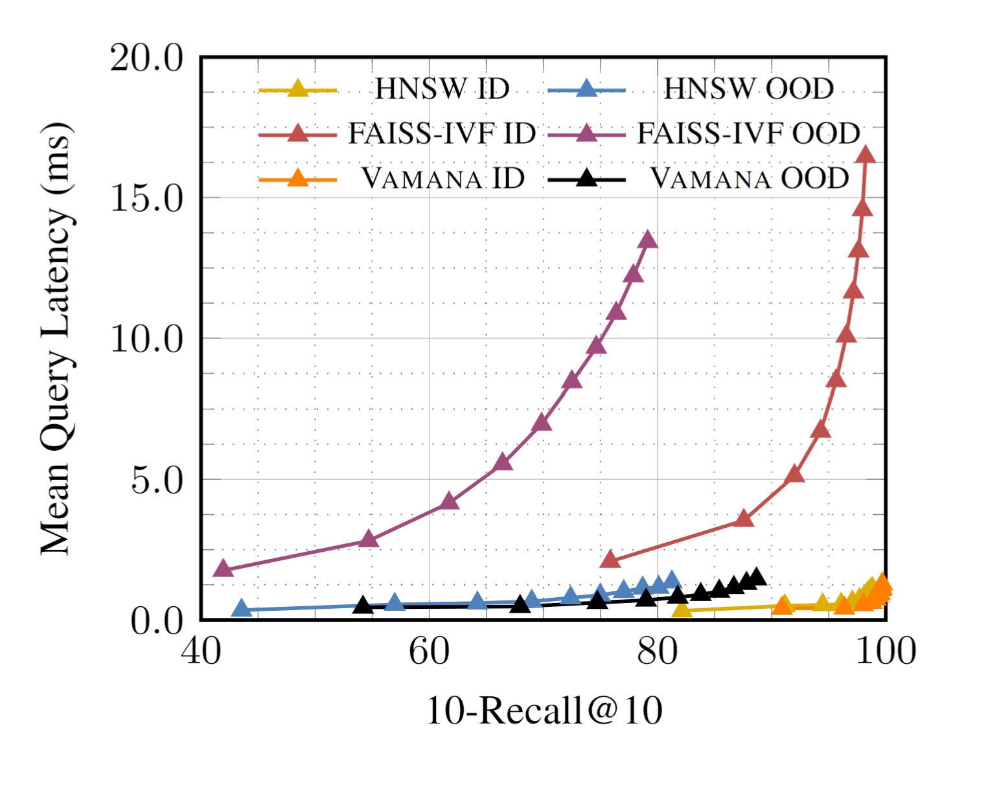
Direction 2: Out of Distribution queries
Data-dependent ANN indices overfit to index data distribution
Lower recall/efficiency when queries are drawn from different distribution
Typical of multi-modal scenarios:
e.g. text queries – image index
Question: given a sample set from the query distribution, can we build an index that is accurate/efficient for new queries?
Yandex Text-to-Image dataset (10M points)
Text queries, Image descriptor index
[Plot Credit: Shikhar Jaiswal]

Slide 31
Direction 3: Analyze convergence properties
[SPECULATIVE]
O(log n) degree + O(log n) farthest path from center??
Number of alternate paths required to achieve (1-ε) recall@k is O(poly(k)/ (ε*g_{k})) where g_{k} is the gap between distance between d(q,v_{k}) and d(q,v_{k+1}) where v_{i} is the i-th nearest point to q ?
Is recall stable under insertions and deletions?

Slide 32
Direction 4: Linearizability and crash recovery
Premise: Graph index asynchronously updated by inserts/deletes and looked up by searches
Questions:
Can we linearize concurrent operations to the graph index?
Can we take periodic snapshots so we can recover from crashes?
Connections to work on streaming graph indices, e.g., functional data structures for graphs using Aspen [Dhulipala, Blelloch and Shun, PLDI’19]

Slide 33
Direction 5: Trillion-node graphs
Search complexity of graph indices scales sub-linearly with size of indices.
Searching 1X 1B DiskANN index much more efficient than 10X 100M indices.
Can we extend this behavior to trillion-point graphs using fault-tolerant distributed memory machines?

Slide 34
Direction 6: jointly train embeddings + ANNS
Current paradigm: Train embeddings for the dataset and later index the embeddings
Question: Can joint training of embedding + ANNS lead to both better relevance and query efficiency
Prior work on joint learning of hashing and clustering based ANNS along with embeddings: (BLISS?) Distill-VQ

Slide 35
https://github.com/Microsoft/DiskANN https://big-ann-benchmarks.com
Notes:
In summary, we have developed the first truly streaming ANNS system that provides stable and high recall using SSD-resident indices.
The logical next steps in research consists of better understanding graph algorithms and the guarantees that they can provide. We also think research on bringing ANNS closer to the training of relevance models could yield more relevant search systems.
On the Microsoft side, we have already shipped these algorithms with strong impact on revenue, and we expect to further scale out to new scenarios. We look forward to more current collaborations to mature over the next year or two. For instance, we are working closely with the Substrate team to design new ANNS indices suitable for transactional database systems that host email and O365 data.
Similarly, we are open to thinking about new search scenarios (say Azure search) and we are excited to tackle new indexing problems that arise from practical systems.

